Slide 1

AI Engineer Agentic Track
The Complete
Agent & MCP
Course
Week 5
Day 1

Slide 2
Week 6: MCP
Agentic
Architecture
and MCP
Building an
MCP Server
and Client
Multiple Local
and Remote
MCP servers
Project 8: AI
Equity Traders
Project 8: AI
Equity Traders
In Action
Week 5: Agent Frameworks
Google ADK and A2A
Strands and Pydantic AI
MAF and
Agno
Mastra
Project 7:
Agent
Loop
Week 4: LangGraph
LangChain Core
LangGraph
LangChain
create_agent
Deep Agents
Project 6:
Sidekick
Week 3: CrewAI
Understand
Crew AI
Concepts
Build a Crew
Agent
Project 4: Stock
Picker
Project 5:
Developer
Agent
Project 5:
Engineering
Team
Week 2: OpenAI Agents SDK
Understand
OpenAI Agents
SDK concepts
Project 2: an
SDR
Tools vs Agents
Guardrails
Project 3: Deep
Research
Project 3: Deep
Research app
Week 1: Foundations
Make an
Agentic
Workflow
Agents and
Agentic
Patterns
Orchestrating
LLMs
Autonomy and
Tools
Project 1:
Your personal
career agent

Slide 3
The week ahead
Know one, know them all
The big idea The framework rarely matters; learn one and you know them all
Day 1: Google ADK The deepest dive, in Python on Gemini, with a short A2A sidebar
Day 2: Strands and Pydantic AI The same five steps in each
Day 3: MS Agent Framework and Agno Two more in Python
Day 4: Mastra The same agent, now in TypeScript
Day 5: Project 7, Agent Loop Five agents build one language-tutor site

Slide 4





What is an agent?
A reminder from Week 1
The definition An LLM, in a loop, with tools, to achieve a goal
An LLM The brain that does the reasoning
In a loop It keeps going, step after step
With tools It runs tools to act on the world
To achieve a goal An objective it drives toward until the job is done

Slide 5





The five steps
The same path through every framework
1. Create the agent Give it a model and a system prompt
2. Run it Send a message, get a reply, still a plain LLM call
3. Add tools Plain typed functions the agent can call
4. Add MCP Plug in a tool server someone else wrote
5. Loop with a goal Hand it a goal and let the framework run until done

Slide 6
Introducing Google ADK
A fast-moving, code-first toolkit
Apr 2025 Open-sourced at Cloud Next
May 2025 Python 1.0.0, Java joins
Dec 2025 TypeScript SDK arrives
May 2026 2.0.0 graph Workflow Runtime
Jun 2026 2.2.0 leads the 2.x line
Today 1.x still patched alongside 2.x

Slide 7
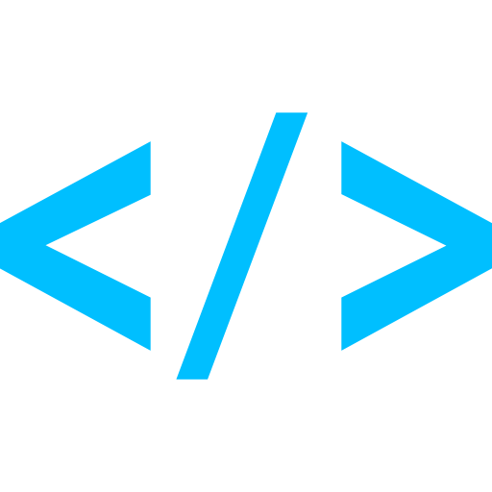



ADK key features
What stands out
Code-first Agents and tools in plain Python
A typed function is a tool Type hints and a docstring are enough, no decorator
adk web A local playground that renders the full trace live
MCP and A2A Both first-class, MCP for tools, A2A between agents
Model-flexible Gemini natively, any OpenAI model via LiteLLM
The trade-off A heavier stack and more plumbing than lighter frameworks

Slide 8

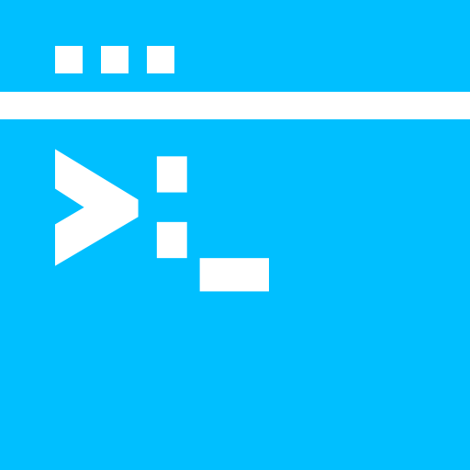



A2A
Agent-to-agent
The standard A Linux Foundation way for agents to find and call each other
Two calls in ADK to_a2a exposes an agent, RemoteA2aAgent consumes one
The agent card Served at a well-known URL so a client learns who an agent is
Adoption The spec is real and clean, uptake is not there yet
The MCP overlap positioned as a complement to MCP, but you can use MCP to call Agents too

Slide 9
Week 6: MCP
Agentic
Architecture
and MCP
Building an
MCP Server
and Client
Multiple Local
and Remote
MCP servers
Project 8: AI
Equity Traders
Project 8: AI
Equity Traders
In Action
Week 5: Agent Frameworks
Google ADK and A2A
Strands and Pydantic AI
MAF and
Agno
Mastra
Project 7:
Agent
Loop
Week 4: LangGraph
LangChain Core
LangGraph
LangChain
create_agent
Deep Agents
Project 6:
Sidekick
Week 3: CrewAI
Understand
Crew AI
Concepts
Build a Crew
Agent
Project 4: Stock
Picker
Project 5:
Developer
Agent
Project 5:
Engineering
Team
Week 2: OpenAI Agents SDK
Understand
OpenAI Agents
SDK concepts
Project 2: an
SDR
Tools vs Agents
Guardrails
Project 3: Deep
Research
Project 3: Deep
Research app
Week 1: Foundations
Make an
Agentic
Workflow
Agents and
Agentic
Patterns
Orchestrating
LLMs
Autonomy and
Tools
Project 1:
Your personal
career agent

Slide 10

AI Engineer Agentic Track
The Complete
Agent & MCP
Course
70%
Complete

